Slide 1

SAP BTP ABAP on Cloud / RAP Training
DAY-11
Anubhav Oberoy
www.AnubhavTrainings.com
Follow excellence with sheer passion

Slide 2


DISCLAIMER
The training content and delivery of this presentation is confidential, and cannot be recorded, or copied and distributed to any third party, without the written consent of Anubhav Trainings

Slide 3

01
Authorization
02
Prechecks
03
Augment
04
Virtual Elements
Notes:
https://pixabay.com/photos/san-francisco-transamerica-pyramid-1633203/

Slide 4

Development Flow – Processor and Approver
Fiori App – Processor
Create, update, delete, copy travel
Fiori App – Approver
Display the travel request data
Service definition
Service Binding
Service definition
Service Binding
MDE for Processor Projection
MDE for approver Projection
BDEF Projection
For Processor
Expose what is needed by a processor role in company
Behavior Definition (BDEF)
Tell RAP framework regarding our operations which needs to be supported for BO (managed)
BDEF Projection
For Approver
Expose what is needed by a approver role in company
Business Object Projection
For Processor
30 fields to internet
Business Object (definition)
Includes the Travel, Booking and Booking Supplement CDS entities
100 fields
Business Object Projection
For Approver
25 fields
www.anubhavtrainings.com

Slide 5
EML – Entity Manipulation Language
The EML is part of ABAP language that access to RAP BO. Because the consumption of business object via odata protocol requires a Fiori UI or Web API, the EML enables a type-safe access to business object directly. EML interacts with the business object entities (single entity – travel) to perform all the entity operations.
EML can be used to provide behaviour for business object. For example, we can implement an action that first triggers a create and then a update using the EML. It is one of the best way to consume our RAP framework and Business object using plain ABAP code w/o creating any special API or service.
Use cases:
Consumption of RAP functionality in Plain ABAP
Testing purpose
Build special business logic
Generate test data
For integration with classic code
www.anubhavtrainings.com

Slide 6
Syntax for EML
Read operation
Read from Root entity and by the key
Read the root entity with its composition child (travel and booking together)
A read operation always either returns a RESULT 🡺 capture in a internal table
OR returns an error table called as FAILED 🡺 capture in a internal table
AND returns an table of messages as REPORTED 🡺 capture in a internal table (other messages)
If we use second option we can specify the associated entity using \_AssociationName
READ ENTITIES OF RootEntityName
ENTITY EntityAlias FROM keys ---(primary key value)
RESULT lt_result
BY \_Composition FROM child_keys
RESULT lt_result_child
FAILED lt_failed
REPORTED lt_reported.
www.anubhavtrainings.com

Slide 7
Update and Delete operations
MODIFY ENTITY OF EntityName AS alias_name
ENTITY EntityName
CREATE FROM lt_create
UPDATE FROM lt_update
DELETE FROM lt_delete
CREATE BY \_AssociationName FROM lt_instance_cba
RESULT lt_result
FAILED lt_failed
REPORTED lt_messages
MAPPED lt_mapped.
www.anubhavtrainings.com

Slide 8

Class Pool
Local types for global classes are the bunch of data types and classes with a single global class. It can be defined to ensure better structure of implementation of global class.
Imagine we are developing an application which requires so many classes, each class will have a few methods only.
More number of classes in our application will cause excessive modularization and confusion among our developers.
More number of global classes, will increase the chance of code being exposed to other programs which we want to keep as private.
We need a mechanism which is a good trade-off between modularization, reuse and maintenance w/o exposing too much functionality to the caller of our application code. We should never have too many objects, especially when each class have just a few methods.
At times, we need to add only a few functions inside a class but likewise we need so many many classes, managing these classes and their lifecycle including transport will be a big task inviting maintenance also for future and making over all design very complex.
www.anubhavtrainings.com

Slide 9
Behavior Pool
The transaction behavior of a BO in the context of RAP is implemented in one or more than one global class.
These special classes are dedicated only to implementing the business object behavior and called as behavior pool.
You can assign any number of behavior pool to behavior definition (a 1:n relationship)
Within a single global class, we can define multiple local classes that can handle the business object behavior.
The global class is just like a container and basically empty while the actual behavior logic is written inside the class pool.
We can assign any number of behavior pool to behavior definition (1:n). This allows us to distribute our implementation across multiple units. This is called contribution design pattern. Which allow team to work in parallel on multiple tasks.
A behavior implementation class always inherits from cl_abap_behavior_handler class.
Travel
(root)
Behavior pool
Helper classes
Booking
Behavior pool
Booking Suppl
Behavior pool
www.anubhavtrainings.com

Slide 10
Implicit Response Parameters
When implementing a BO contract, we can make use of implicit parameters. These parameters do not have FIX data type, instead they are assigned by the compiler with the type derived from BDEF.
The implicit parameters can be declared explicitly as CHANGING parameters in the method signature of the class using generic type
DATA: lt_imp_param FOR <OPERATION> entity.
Data : lt_mapped FOR CREATE BO-Travel.
FAILED
This is an exporting parameter which is defined as nested table contains one table for each entity. The failed table includes the information for identifying the data set where the error occurred. It has %CID, the ID of the BO instance, %FAIL which has the reason of failure. If_abap_behv=>t_failinfo
REPORTED –
This is an exporting parameter which is defined as nested table contains one table for each entity.it includes the instance specific messages.
%CID, ID of the relevant BO, %MSG with the message interface, %ELEMENT
MAPPED – Only during Create/Update operation
This is an exporting parameter which is defined as nested table contains one table for each entity. The mapped parameter provide the consumer with ID mapping information. They include information about key values were created by the application for given content id. The BO runtime passes the created key values in any subsequent call in the sample request.
%CID and %KEY
www.anubhavtrainings.com

Slide 11
BO instance features
Early numbering
It allows a managed numbering for bo instances during creation process. Like in ABAP we use sequence numbers (SNRO) to auto generate primary keys, here in RAP we can use early numbering. It can be handled for all the entities. For this we need to implement the logic in RAP BIMP.
Every assigned key must be unique, otherwise the instances will be rejected by the database which will result to dump. We will be reusing a SNRO sequence already created by SAP in the system.
www.anubhavtrainings.com

Slide 12
Sequence of calls
Fiori app
OData
RAP
BIMP
HANADB
entities
FAILED, MAPPED, REPORTED
www.anubhavtrainings.com

Slide 13
Development Flow – Processor and Approver
Fiori App – Processor
Create, update, delete, copy travel
Fiori App – Approver
Display the travel request data
Service definition
Service Binding
Service definition
Service Binding
MDE for Processor Projection
MDE for approver Projection
BDEF Projection
For Processor
Expose what is needed by a processor role in company
Behavior Definition (BDEF)
Tell RAP framework regarding our operations which needs to be supported for BO (managed)
BDEF Projection
For Approver
Expose what is needed by a approver role in company
Business Object Projection
For Processor
30 fields to internet
Business Object (definition)
Includes the Travel, Booking and Booking Supplement CDS entities
100 fields
Business Object Projection
For Approver
25 fields
www.anubhavtrainings.com

Slide 14
Sequence of calls
Fiori app
OData
RAP
BIMP
HANADB
entities
FAILED, MAPPED, REPORTED
www.anubhavtrainings.com

Slide 15
Exercise
Assign the booking Supplement ID automatically during creation with early numbering.
www.anubhavtrainings.com

Slide 16
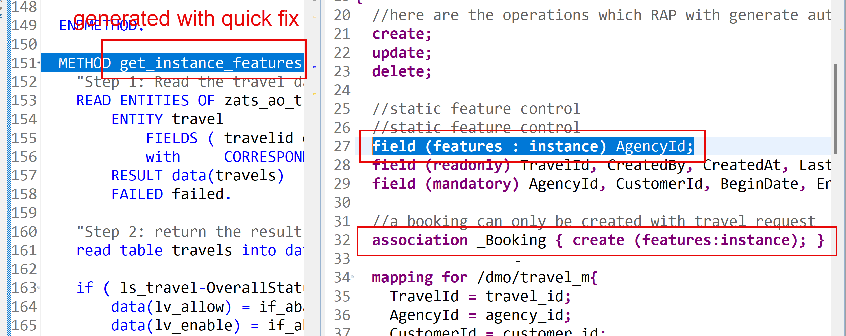
Feature Control
As an application developer we want to determine which entities of our BO needs to allow create-, update-, delete- operations. Apart from that which properties of BO are allowed to be mandatory, read only, creatable, updatable. We can also control the availability of our data actions.
In RAP, feature controls are of 2 types:
Static feature control – are specified at the level of behavior definition only. Statically declared and easy to implement.
Dynamic feature control – complex to implement for more complex requirements. They require a mandatory implementation in BIMP class. We use keyword features:instance
www.anubhavtrainings.com

Slide 17
Data Actions in RAP
In the context of RAP, an action is a non-standard operation that change the data of a BO instance or create new BO instances. They are self implemented operations. There are two main categories of data actions can be implemented in RAP:
Non factory action: Defines a RAP action which offers the non-standard behavior and implement custom logic in handler with MODIFY clause. A non factory action can be of 2 sub types (change a property of a record)
Static – they are not bound to any instance, they are generic and can be applied to all instances, like we want to change the booking fees for all travel request as fix price during promotion period.
Instance – An action that, by default relates to a BO RAP entity instance and changes the state of BO instance. E.g. like approve or reject a travel request where user choose a instance which they want to work with.
Factory Action – A factory action used to create new BO instances. A factory action can be instance-bound (default) or static.
Instance – that copy specific values of an instance and create new instances based on copied data
Static – can be used to create instances with prefilled default values
www.anubhavtrainings.com

Slide 18
Determination
A determination modifies instance of business object based on trigger condition. Trigger condition can be modify operations such as create, update, and delete and modified field. There are 2 types of determination
on modify – will be triggered before save whenever trigger condition is met e.g. when I change booking fee
on save – will always trigger at the time of save
Steps
Add the code for defining the determination in behavior definition, we want to do it in reusable way
Use quick fix to generate the code for determination
Define a structure where we can store all the booking fees and currency code
Read all travel instances, subsequent bookings using EML
Total all booking and supplement amounts which are in common currency
Delete the values w/o any currency
Loop at all amounts and compare with target currency
Perform currency conversion
Put back the total amount
Return the total amount in mapped so the RAP will modify this data to DB
www.anubhavtrainings.com

Slide 19
Validations
Many times we would like to perform business specific checks in our application, The rap framework is only responsible to perform CURDQ operations. It does not know what are all the business rules applies to our code.
If we return FAILED and MESSAGE then the RAP will terminate the update/create and shows the message to the user on Fiori App.
www.anubhavtrainings.com

Slide 20
Development Flow – Processor and Approver
Fiori App – Processor
Create, update, delete, copy travel
Fiori App – Approver
Display the travel request data
Service definition
Service Binding
Service definition
Service Binding
MDE for Processor Projection
MDE for approver Projection
BDEF Projection
For Processor
Expose what is needed by a processor role in company
Behavior Definition (BDEF)
Tell RAP framework regarding our operations which needs to be supported for BO (managed)
BDEF Projection
For Approver
Expose what is needed by a approver role in company
Business Object Projection
For Processor
30 fields to internet
Business Object (definition)
Includes the Travel, Booking and Booking Supplement CDS entities
100 fields
Business Object Projection
For Approver
25 fields
www.anubhavtrainings.com

Slide 21
Determination
A determination modifies instance of business object based on trigger condition. Trigger condition can be modify operations such as create, update, and delete and modified field. There are 2 types of determination
on modify – will be triggered before save whenever trigger condition is met e.g. when I change booking fee
on save – will always trigger at the time of save
Steps
Add the code for defining the determination in behavior definition, we want to do it in reusable way
Use quick fix to generate the code for determination
Define a structure where we can store all the booking fees and currency code
Read all travel instances, subsequent bookings using EML
Total all booking and supplement amounts which are in common currency
Delete the values w/o any currency
Loop at all amounts and compare with target currency
Perform currency conversion
Put back the total amount
Return the total amount in mapped so the RAP will modify this data to DB
www.anubhavtrainings.com

Slide 22
Validations
Many times we would like to perform business specific checks in our application, The rap framework is only responsible to perform CURDQ operations. It does not know what are all the business rules applies to our code.
If we return FAILED and MESSAGE then the RAP will terminate the update/create and shows the message to the user on Fiori App.
www.anubhavtrainings.com

Slide 23
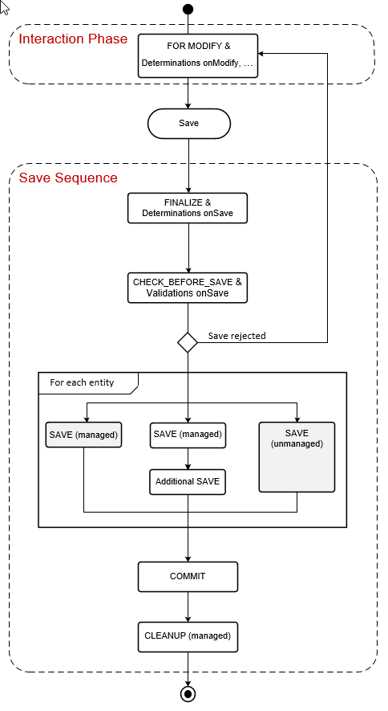
www.anubhavtrainings.com

Slide 24
Side Effects
Side effects are useful in UI scenarios based on BO which makes the Fiori element UI know/aware about the data changes in backend. Whenever data is reevaluated in backend, the frontend is unaware of that, we need to make sure that the frontend make a forceful call to GET the data back on UI.
The Fiori UI will never make an unnecessary call to perform a round trip. If we know that, a change in a field would certainly change the data in SAP system, we need to inform the same to RAP BO, so that it can make a GET call to reload the particular field value and display the updated data on UI. E.g. when we change the booking fee, or flight price under booking table, we need to reload the total price (which is getting calculated in backend using determination), this is exactly what the side effect can do for us.
www.anubhavtrainings.com

Slide 25
Draft
Draft is a very important functionality of an enterprise application, which allows us
To create a stateful application from stateless
Store intermediate data in sap system
Perform validations on-fly, increases the collaboration with our app
Device switch
The Odata V4 never allow CURD operation without having draft feature to your BO
www.anubhavtrainings.com

Slide 26
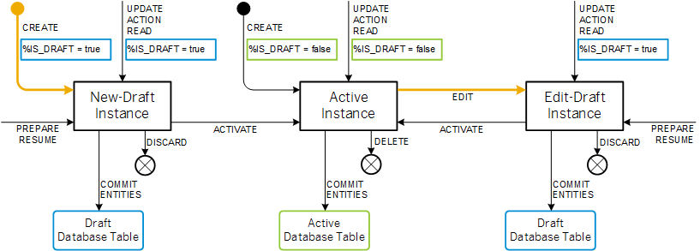
Draft Runtime
www.anubhavtrainings.com

Slide 27
Authorization
Authorization control in RAP protects our business object against the unauthorized access of data. Authorization control is always relevant when the permission to execute an operation depends on a role of BO consumer. In the RAP, each read or modify request can be checked via authorization object against the user role before the request is finally executed and reaches data.
The auth check with auth object is called from cds entities in case of read request – was covered in Anubhav trainings abap on hana course
And behavior implementation in case of modify request
Global authorization
Global authorization is used for all authorization checks that only depends on the user.
Global authorization checks can be implemented both for static and instance bound operations
Instance authorization
Instance authorization is used for all auth checks that, in addition to the user role, depend on the state of the entity instance in question (like exact record level). Its only possible for instance based operation
Operations that are executed from instance auth are CREATE and static actions
Use case: when a user tries to edit a travel request, if the travel request status is cancelled, then we need to check that if he/she is a manager or not. Only managers can edit a cancelled travel request. Since each travel request is different, we need to go with instance-based authorizations.
www.anubhavtrainings.com

Slide 28







Prechecks
While the system is saving the draft in the draft table we can use prechecks to make sure that checks/authorizations are checked in the system before data reaches to draft table. Unlike validations (while saving/updating data to main table) Prechecks will trigger before data reaches to transaction buffer.
They are very helpful when we even want to validate data of one control based on another control. Currently as a developer you need to take additional pain to clean the data when draft is activated. If you apply precheck, system ensures that only the clean data reaches to transaction buffer.
www.anubhavtrainings.com

Slide 29
Augment
Before data reaches to transaction buffer, the augment code will be executed and here we can set some default data to the BO instance.
www.anubhavtrainings.com

Slide 30
Virtual Elements
There is a requirement to expose extra elements out of cds entities for which there is no data inside the database, basically these element values are calculated at runtime (on-fly). If you worked with SAP UI5 development, we have similar concept called formatter. We have a implementing class in which we will add our code for calculating the runtime data of virtual elements.
Rules:
We should only add them to projection view. Because if you add in main view, your draft table will disturb and your main table will never have these column.
RAP does not support filtering and sorting of virtual elements, also the aggregation and group is not allowed
We cannot select data from virtual elements using direct SELECT or EML
We have to write implementation in a class for virtual element that class must use the interface IF_SADL_EXIT_CALC_ELEMENT_READ.
www.anubhavtrainings.com

Slide 31
Steps to implement the approver scenario
Go to base behavior definition and add non factory actions, provide implementation for the same
Create copy from processor cds entity projections and make new cds entities for projection for approver. Both travel and booking, ignore the booking supplement as a approver will only allowed to view upto the booking data.
Create metadata extensions for approver. Since approver can only see the data of travel and booking, we only created 2 MDE. Keep all the relevant fields and integrate code to show accept and reject travel buttons.
Now we provide behavior definition projection for approver which controls what an approver can do. As we know an approver can only edit bookingfee and travel status, he/she not allowed to create/update/delete any of the entities.
Customize our BDEF according to the needs of our user scenario.
Create a service definition for approver and service binding for approver.
Testing ☺
www.anubhavtrainings.com

Slide 32
Steps to implement the approver scenario
Go to base behavior definition and add non factory actions, provide implementation for the same
Create copy from processor cds entity projections and make new cds entities for projection for approver. Both travel and booking, ignore the booking supplement as a approver will only allowed to view upto the booking data.
Create metadata extensions for approver. Since approver can only see the data of travel and booking, we only created 2 MDE. Keep all the relevant fields and integrate code to show accept and reject travel buttons.
Now we provide behavior definition projection for approver which controls what an approver can do. As we know an approver can only edit bookingfee and travel status, he/she not allowed to create/update/delete any of the entities.
Customize our BDEF according to the needs of our user scenario.
Create a service definition for approver and service binding for approver.
Testing ☺
www.anubhavtrainings.com

Slide 33
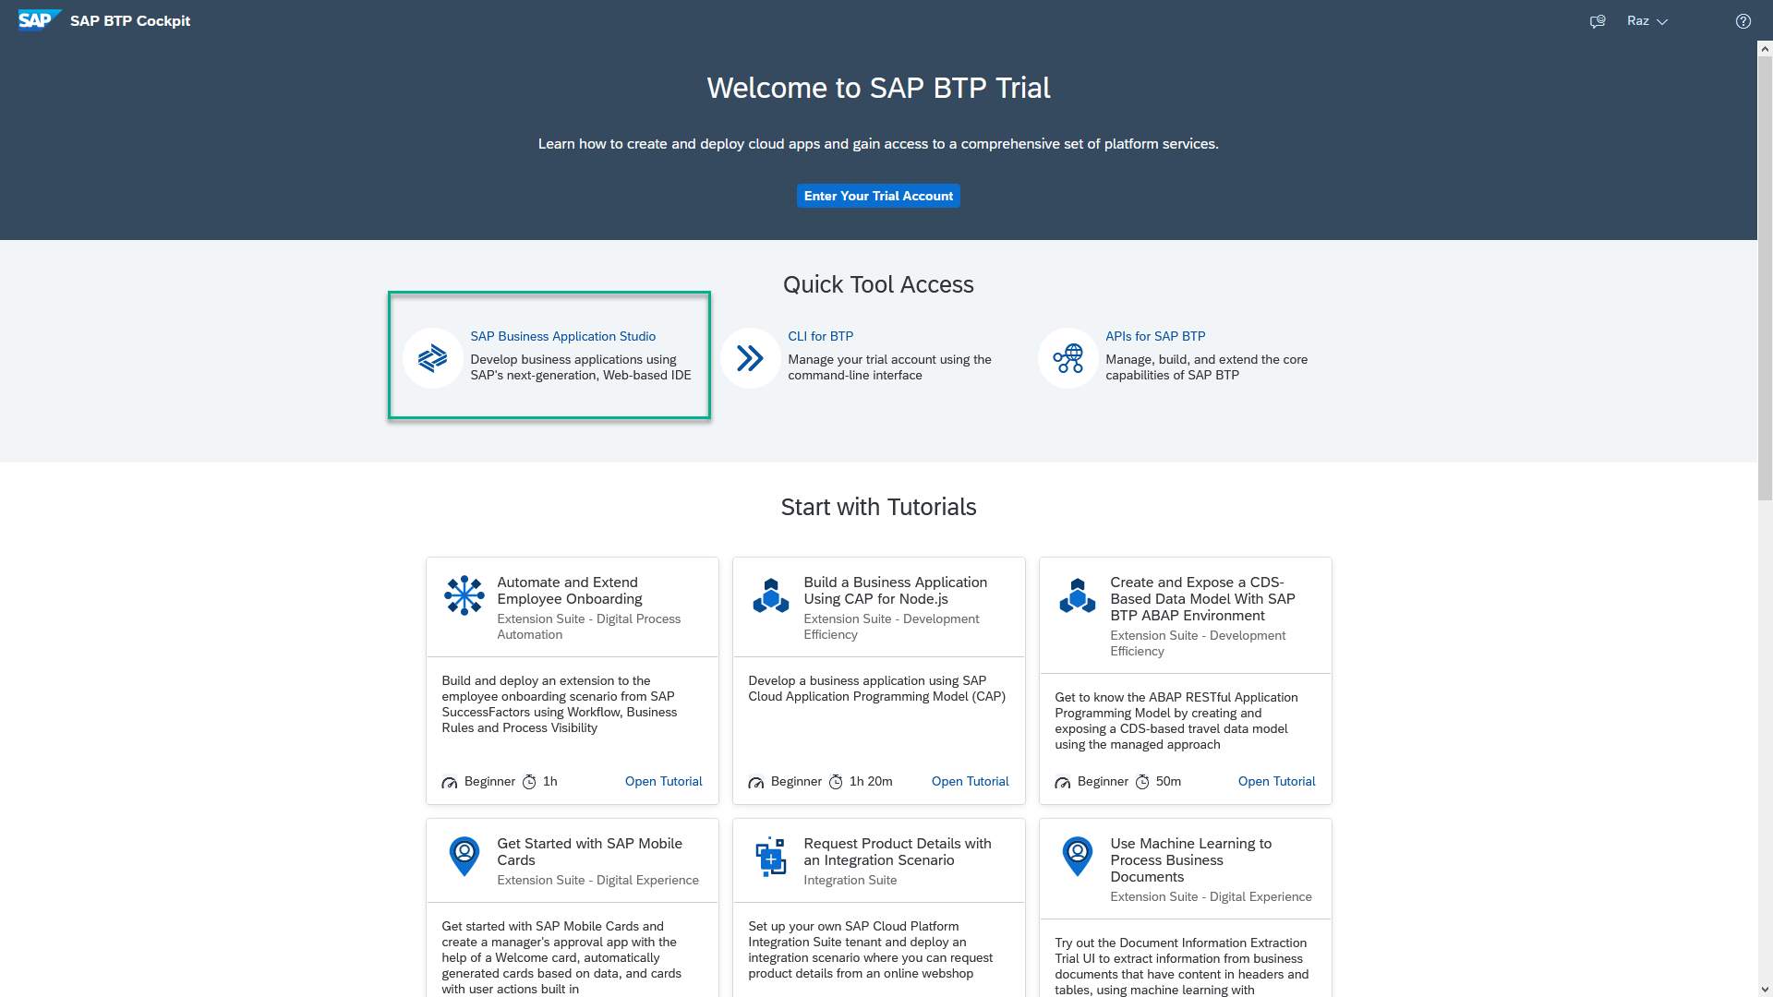
Business Application Studio
SAP Business Application Studio is a development environment available on SAP Business Technology Platform. It is a multi cloud development environment to create different kinds of Apps like HANA Native, CAPM, Fiori, MDK etc. A developer must create private dev space in the system in order to build application in BAS tool, All the required tooling is pre-configured in BAS.
In an Enterprise Account you can set up SAP Business Application Studio as a Free-Tier service by checking its free plan during its entitlement configuration.

Slide 34
Dev Space in BAS
We don’t want a single developer to consume all the available resources
We want a clear isolation of one developer with another
Pre-configured by sap for specific development
Solution - Virtualize
Dev Space
Dev Space
Dev Space
SAP BAS – Business App Studio
SAP BTP – Platform as a Service
IaaS – Infrastructure as a Service

Slide 35
www.anubhavtrainings.com
Thank You
End of Day 11
www.anubhavtrainings.com

Slide 36


We’re committed to empower you to be
#FutureReady
through powerful training solutions.
We build the workforce of the future.
250+
Corporate Clients
30,000+
Learners Trained
25000+
Learners Placed
FREE WEBINARS
Sign up for free webinars with industry experts every fortnight!
Enroll Now!
Contact us today!
https://anubhavtrainings.com

